Slide 1
Chapter 8. Monte Carlo simulations

Slide 2
Monte Carlo simulations
Introduction
Probability distribution function
Integration
The Metropolis algorithm

Slide 3
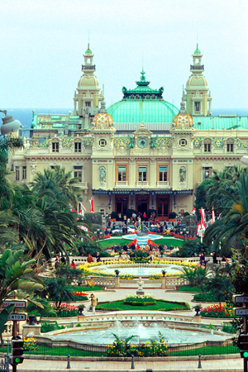
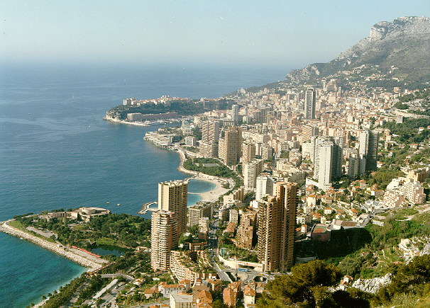
What is Monte Carlo?
Monte-Carlo, Monaco
Monte Carlo Casino

Slide 4
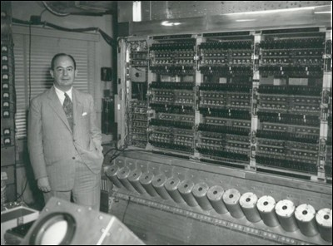
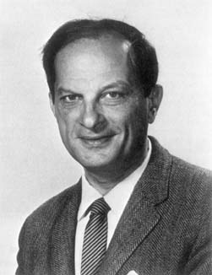
Monte Carlo method: computational statistics
Birthday: World War II, 1940s
Father: S. Ulam
Birth Place: neutron reaction in atom bomb, Manhattan Project
Von Neumann
(1903-1957)
Stanislaw Ulam
(1909-1984)

Slide 5
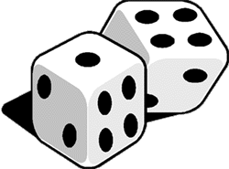
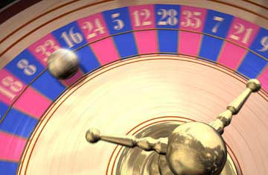
Monte Carlo method
Computational algorithms that rely on repeated random sampling to obtain numerical results
use randomness to solve problems that might be deterministic

Slide 6
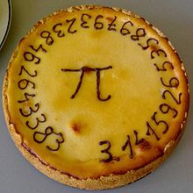
A history of π (pie):
Time | Who | Value
~2000-1850 BC | Egyptian 阿美斯纸草书 | 256/81=3.160493....
~1900 BC | Babylonian | 25/8=3.125
~900 BC | Indian (Shatapatha Brahmana) | 339/108=3.13888
~600 BC | Hebrew 希伯来圣经 | 3
~250 BC | Αρχιμήδης | 3.14163491
~100 BC ? | Chinese 周髀算经 | 3 径一而周三

Slide 7
Time | Who | Value
~20 BC | Vitruvius | 3.125
~50-23 BC | 刘歆 | 3.1547
~130 AD? | 张衡 | 3.146551
~150 AD | Πτολεμαῖος | 3.141666
250 AD | 王蕃 | 3.155555
263 AD | 刘徽 | 3.141024 <π < 3.142104
400 AD | 何承天 | 111035/35329 = 3.142885...
480 AD | 祖冲之 | 3.1415926 <π < 3.1415927
A record for one thousand years!!!

Slide 8
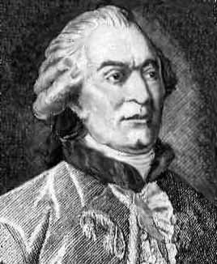
Buffon’s needle to calculate Pi
Throw a needle randomly on a sheet on which parallel lines with an equal distance are drawn.
Counts the number of throwing which makes the needle crossing the parallel lines.
Georges Buffon
(1707 ~ 1788)
For
You can get π by random throws.

Slide 9
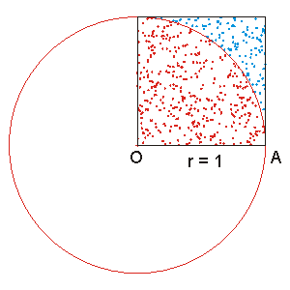

Darts method to calculate Pi
Circle: πr²/4=π/4
Square: r²=1
Darts.cpp

Slide 10
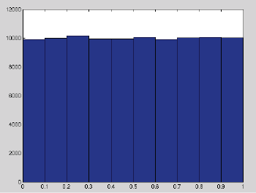
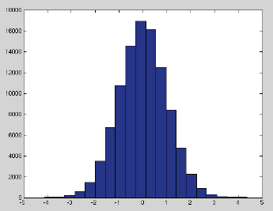
Probability distribution function (p.d.f.)
Uniform distribution
Gaussian or normal distribution

Slide 11
Overview of pdf and cdf
Basic definition of probability distribution function (p.d.f.):
And its integral, the cumulative distribution function (c.d.f.):

Slide 12
Important properties of continuous and discrete pdf ’s
Properties
Continuous: f(x)
Discrete: {p_{i}}
Positivity
Normalization
Interpretation
Mean
Variance

Slide 13
Random-number generators
Uniform distribution U[0,1)
Not a number but a sequence with random numbers
Random number generators:
Real random number (RRN) generators: Quantum processes like nuclear decay
Pseudo-random number (PRN) generators: Lottery, computational PRN: depends on the initial one, algorithm, and word length

Slide 14
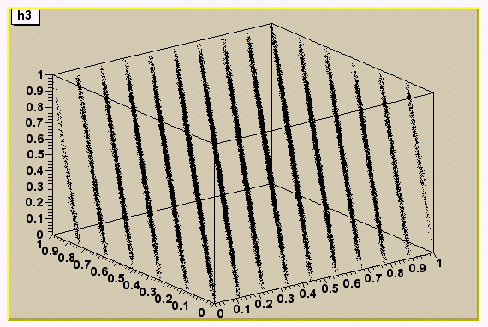
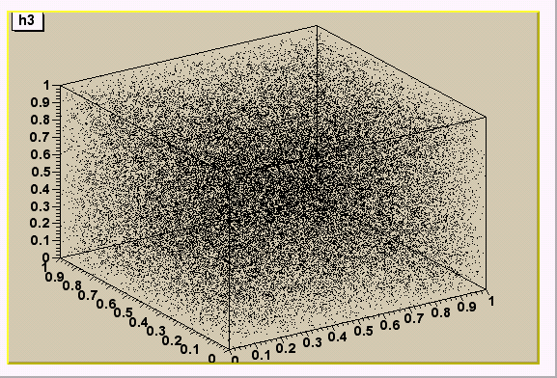
Good PRN
Bad PRN

Slide 15
Linear congruential generator
Pseudo-random number (PRN) generators
Generating a random sequence of numbers {X1,X2,…….,Xk} of length M over the interval [0,M-1]
Xi=mod(AXi-1+C,M)
R=Xi/M
note that mod(b,M)=b-int(b/M)*M
Starting value X0 is called “seed”
M,A and C are nonnegative integers known
Modulus, multiplier and increment, respectively

Slide 16
Fortran program
program random_num
implicit none
integer,parameter::m=2**21,a=17,c=43
integer::i,n,s
real(8)::R,Xo
read*,n
!n is the number of random points
Xo=27.0d0
!------------------------
do i=1,n
s=A*Xo+c
Xo=mod(s,m)
R=Xo/m
write(*,*) R
end do
!------------------------
end program random_num

Slide 17
Use Fortran Intrinsic Subroutine
REAL x, array1(5, 5)
CALL RANDOM_SEED()
CALL RANDOM_NUMBER(x)
CALL RANDOM_NUMBER(array1)

Slide 18
PRN function in C/C++
void srand( unsigned int seed );
int rand( void )
The rand function returns a pseudorandom integer in the range 0 to RAND_MAX.
Use the srand function to seed the pseudorandom-number generator before calling rand.
Or you will always get the same number sequence!

Slide 19
Random Variate Generation
Approaches for random variate generation:
Inverse Transformations
Acceptance/Rejection
Direct Transformation

Slide 20
Inverse Transformations
Random-Variate generation is converting from a random number (R_{i}) to a Random Variable, X_{i} ~ some distribution.
Inverse transform method:
Step 1 – compute cdf of the desired random variable X
Step 2 – Set F(X) = R where R is a random number ~U[0,1)
Step 3 – Solve F(X) = R for X in terms of R. X = F⁻¹(R).
Step 4 – Generate random numbers R_{i} and compute desired random variates:
X_{i} = F⁻¹(R_{i})

Slide 21
Special trivial case
If X_{i} ~U[0,1)
cdf F(X)=X
F(X) = R
X = F⁻¹(R)=R
pdf f(X)=1 for 0≤x<1
R is a random number ~U[0,1)

Slide 22
General case
R obeys uniform distribution U[0,1)
Let T(R)=X so that X is a random variable with a given pdf, what is T(R) (monotonically increasing)?

Slide 23
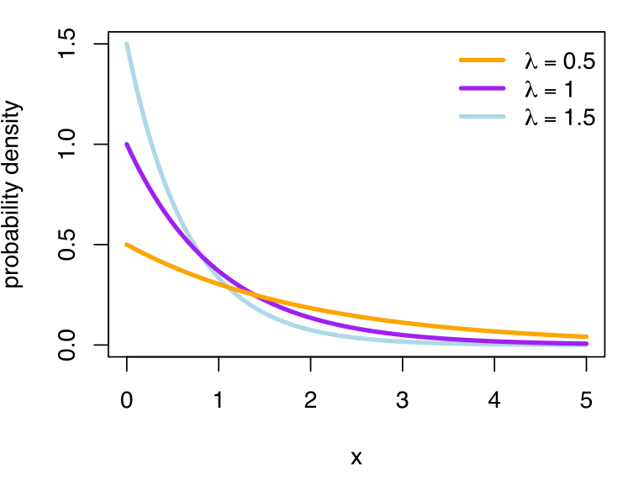
Example
Recall Exponential distribution: λ is often thought of as the arrival rate, and 1/λ as the time between arrivals

Slide 24
Inverse transform method – Exponential Distribution:
Step 1 – compute cdf of the desired random variable X
Step 2 – Set F(X) = R where R is a random number ~U[0,1)
Step 3 – Solve F(X) = R for X in terms of R. X = F⁻¹(R).
Step 4 – Generate random numbers R_{i} and compute desired random variates:

Slide 25
Acceptance/Rejection Method
Use when it is either impossible or extremely difficult to express x in terms of the inverse transformation F⁻¹(R).
The acceptance-rejection method is an algorithm for generating random samples from an arbitrary probability distribution, given as ingredients random samples from a related distribution and the uniform distribution.
Notes:
30

Slide 26
Steps:
Normalize the range of f by a scale factor c such that f(x)/c ≤ 1, a ≤ x ≤ b
Define a linear function of r, x = a + (b-a) r
Generate a pair of random numbers (r₁, r₂)
If r₂ ≤ 1/c⋅f[a + (b-a) r₁], then accept the pair and use x = a + (b - a) r₁ as the random variate generated.
Return to step 3.
U[0,1)
f(x)
c
a
x
b
Notes:
30

Slide 27
Why it works?
Notes:
30

Slide 28
Example:
Use the rejection method to generate random variates x with distribution function f(x) = 2x, 0 ≤ x ≤ 1
f(x)
2
1
1
c=2
Notes:
30

Slide 29
Note: x = 0 + (1) r = r,
Note: let g(r) = f(r)/c = (1/2) ⋅ (2r) = r
So, the steps for this example are now summarized.
Generate r₁ and calculate g(r₁).
Generate r₂ and compare it with g(r₁).
If r₂ ≤ g(r₁), accept r₁ as x from f(x). If r₂ > g(r₁) then reject r₁ and repeat step 1.
Notes:
30

Slide 30
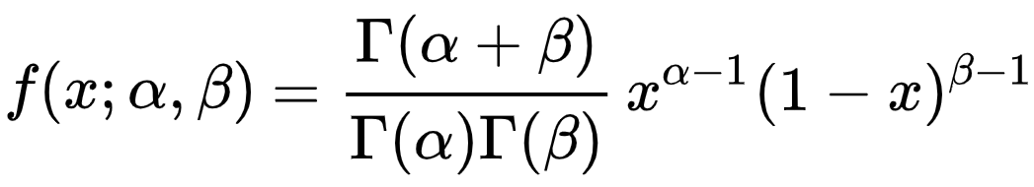
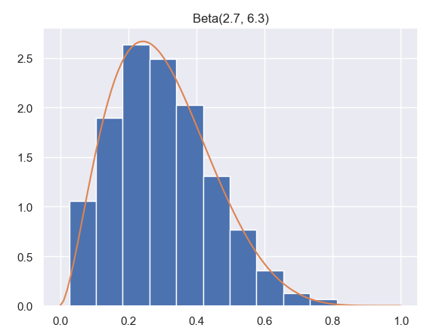
Beta distribution

Slide 31
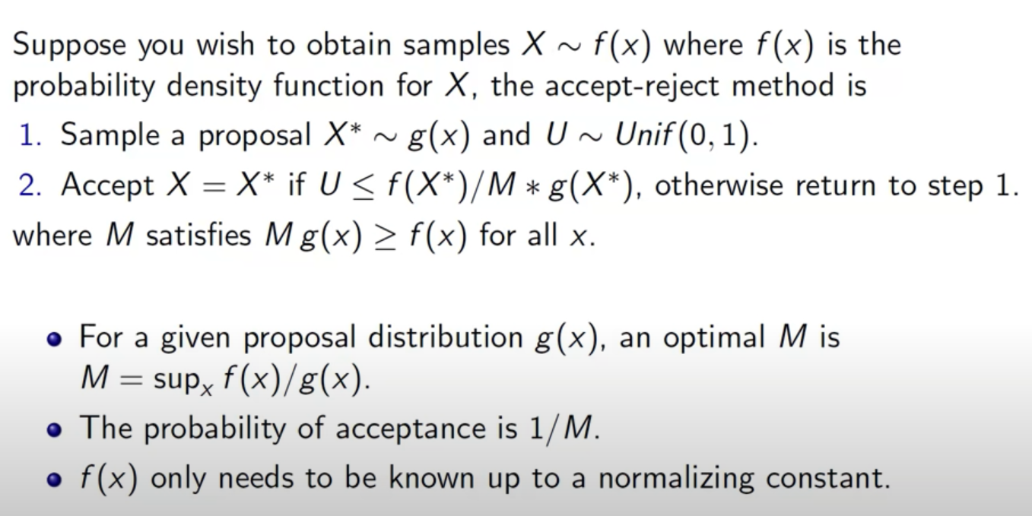
Generalized Acceptance/Rejection Method
von Neumann Rejection Method
[
]

Slide 32
Desired distribution f(x)
g(x) should be scaled so that
Notes:
30

Slide 33
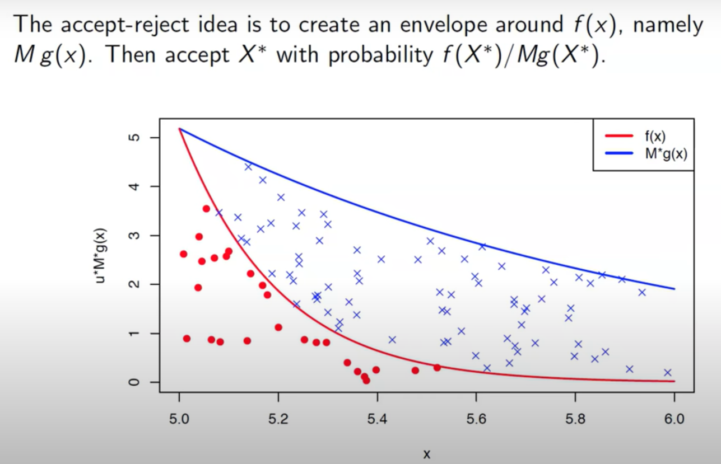

Slide 34
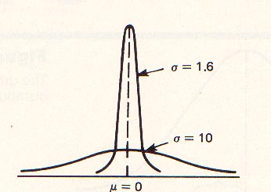
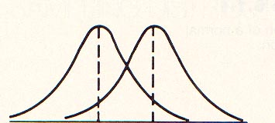
Example
Normal distribution

Slide 35
Exponential distribution
One can generate N(0,1) with generalized acceptance/rejection method using exponential distribution (λ=1)
http://www.columbia.edu/~ks20/4703-Sigman/4703-07-Notes-ARM.pdf

Slide 36
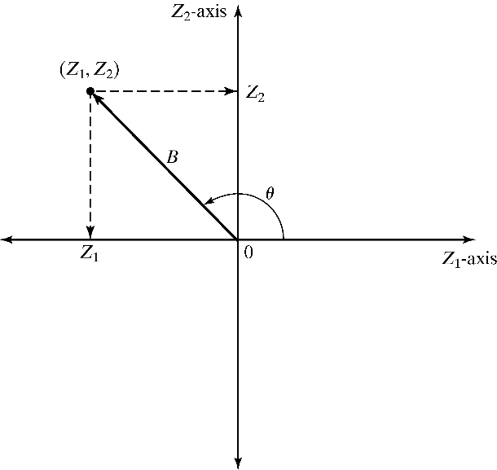
Direct Transformation
Approach for Normal(0,1):
Consider two standard normal random variables, Z₁ and Z₂, plotted as a point in the plane:
B² = Z²₁ + Z²₂ ~ chi-square distribution with 2 degrees of freedom that is equivalent to Exp(λ = 1/2). Hence,
The radius B and angle θ are mutually independent.
In polar coordinates:
Z₁ = B cos θ
Z₂ = B sin θ

Slide 37
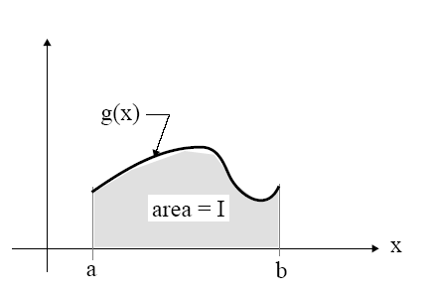
Monte Carlo Integration
Hit and miss method
Sample mean method
Importance sampling method

Slide 38
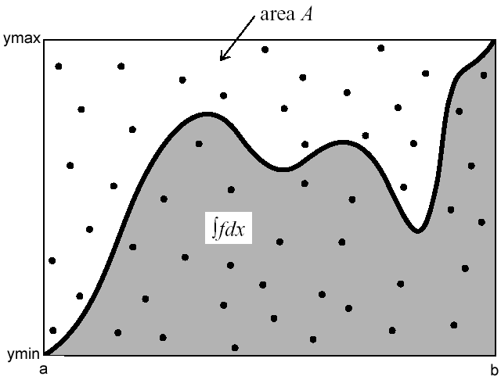
Hit and Miss method
♦Generate two sequence of N of PRN (Ri,Rj)
i& j=1,2,….,N
0 ≤f(x) ≤Ymax, for x Є (a,b)
♦ x_{i}=a+R_{i}(b-a)
♦ Y_{j}=Ymax R_{j}
♦ start from s=0
♦ if Y_{j}<f(x_{i}) s=s+1
♦ I=Ymax(b-a) s/N
Similar to the Darts method to calculate Pi

Slide 39
program Hit_miss
implicit none
real(8)::R(2)
real(8)::X,Y,m,a,b,integ
integer::i,N,s
read*,a !the lower value of the interval
read*,b !the upper value of the interval
M=f(b)
if (dabs(f(a))>dabs(f(b))) M=f(a)
read*,N !the number of random numbers
s=0
do i=1,N
call random_number(R(1))
call random_number(R(2))
X=a+R(1)*(b-a)
Y=M*R(2)
if (y<f(x)) s=s+1
end do
INTEG=M*(b-a)*s/N
print*,integ
contains
real(8) function F(X)
real(8),intent(in)::X
F=2.0*X+1.0
end function F
end program Hit_miss

Slide 40
If there is a part of the function under X-axis
then

Slide 41
Sample Mean method
Sample the points not on regular grids, but at random (uniformly distributed), then
Estimate error using central limit theorem

Slide 42
Central Limit Theorem
If a random sample X of size n is taken from a distribution with mean μ and standard deviation σ, and if the sample size is large, then the sampling distribution of the sample mean is approximately normal with mean μ and standard deviation (or standard error) of σ/n^{1/2}. That is,

Slide 43
Error in sample mean method
Apply central limit theorem to f(x_{i}) (i=1,…,N)
For large N, the sample mean
<f> = (1/N) ∑ f_{i}
follow Gaussian distribution with true mean of f, E(f), and variance
σ² = var(f)/N

Slide 44
Sample Mean MC algorithm
Generate sequence of N of PRN: R_{i}
Compute x_{i}=a+R_{i} (b-a)
Compute f(x_{i}), i=1,2,3,….,N
Use

Slide 45
program Sampled_Mean
implicit none
real(8) :: R
real(8)::a,b,sum,integ,X
integer::i,N
read*,a ! Lower value
read*,b ! upper value
read*,n ! number of random points
sum=0.0d0
do i=1,n
call random_number(R)
X=a+R*(b-a)
sum=sum+f(x)
end do
integ=((b-a)/N)*sum
write(*,*) "integ=",integ
contains
real(8) function F(X)
real(8),intent(in)::X
F=2*X+1.0d0
end function F
end program Sampled_Mean

Slide 46
Comparison of Hit-and-Miss and Sample Mean Method
Sample mean method is generally preferred over Hit-and-Miss method because:
the estimator from sample mean has lower variance
Sample mean method does not require a non-negative integrand (or adjustments)

Slide 47
Generalization to multidimensional cases
Rewrite d-dimension integral
by
Because the uniform distribution, choose
and
The estimate of I is

Slide 48
Why Monte Carlo?
Method | Conv.rate in one dim | Conv.rate in d-dim
Basic MC Trapezoidal rule Simpson’s rule

Slide 49
Suppose we want to solve the following integral using any
other numerical method ,(i.e. Trapezoidal or Simpson)
Where i=1,2,3,……,30
So we generate a grid in the domain of integration, suppose
a grid with 10 nodes on each coordinate axis in 30 dimension cube [0,1]³º be chosen. In this case, we have 10³º abscissas.
Suppose a time of 10⁻⁷ second is necessary for calculating
one value of the function. Therefore, a time of
10¹⁵ years will be necessary for evaluating the integral.

Slide 50
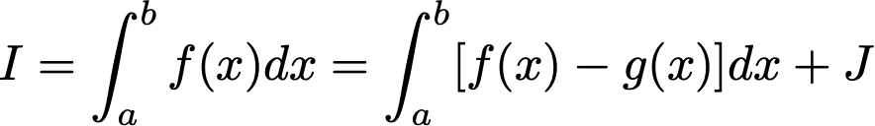
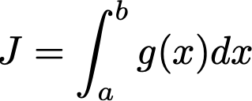
Reduce error of Monte Carlo integration
Increase N (also computation time)
Reduce variance of the function f(x)
One way:
If is known and g(x) is close to f(x)

Slide 51
Importance sampling
Sometimes the accuracy of the integral evaluated from the simple Monte Carlo quadrature is low.
Is there any way to increase the accuracy for some specific types of integrands?
If f (x) is smooth and close to constant, the accuracy from the Monte Carlo quadrature would be much higher.

Slide 52
Steps of importance sampling method
rewrite
by
where
g(x) is a probability distribution function
where
Now make a variable change
and
Then

Slide 53
Now the value of the integration equal to the average value
u_{i} are uniform random numbers
Error estimation:
Choose g(x) so that var(f/g) is small!

Slide 54
Example (Importance sampling method)
find
In this region, the function decreases from 1 to 1/e. The simple exponential function does the same, so let’s use that for g(x). We first have to normalize g, so we
calculate
Then our normalized weighting function is

Slide 55
let
Then

Slide 56
program important_sample
implicit none
real(8)::sum,u,R,integ
integer::i,N
read*,N
sum=0.0
do i=1,N
call random_number(R)
u=G_inv(R)
sum=sum+f(u)/g(u)
end do
integ=sum/N
write(*,*) integ
contains
real(8) function F(x)
real(8),intent(in)::x
F=dexp(-x**2)
end function F
real(8) function g(x)
real(8),intent(in)::x
g=dexp(-x) * 2.718d0/1.718d0
end function g
real(8) function G_inv(x)
real(8),intent(in)::x
G_inv=-dlog(1-x*1.718d0/2.718d0)
end function G_inv
end program important_sample

Slide 57
Difficulty in importance sampling
Hard!

Slide 58
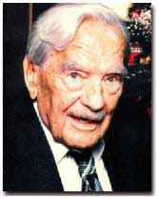
Nicholas Metropolis (1915-1999)
Metropolis algorithm
The algorithm by Metropolis (and A Rosenbluth, M Rosenbluth, A Teller and E Teller, 1953) has been cited as among the top 10 algorithms having the "greatest influence on the development and practice of science and engineering in the 20th century."

Slide 59
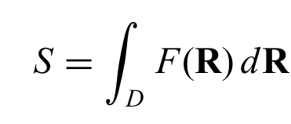
The 3N-dimensional integral is written as
where D is the domain of the integral, R = (r₁, r₂, . . . , r_{N} ), with each r_{i} for i = 1, 2, . . . , N being a three-dimensional vector.
In many cases, the function F(R) is not a smooth function. The idea of importance sampling introduced by Metropolis et al. (1953) is to sample the points from a nonuniform distribution.

Slide 60
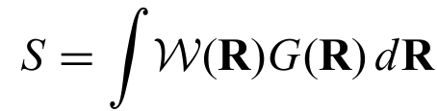
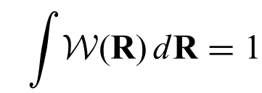
Find a distribution function W(R) which mimics the drastic changes in F(R)
Rewrite the integral as
G(R) = F(R)/W(R)
where W(R) is positive definite and satisfies the normalization condition.

Slide 61
Metropolis algorithm
The selection of the sampling points is viewed as a Markov process.
In equilibrium, the values of the distribution function at different points of the phase space are related by
where T (R → R') is the transition rate from the state characterized by R to the state characterized by R'.
This is usually referred to as detailed balance in statistical mechanics.

Slide 62
Detailed Balance Criterion
: Probability to be at State R at Time t
: Transition Probability per Unit Time
from R to R’

Slide 63
After a Long Time, the System Reaches Equilibrium
At equilibrium, we have:
This will occur if the transition probabilities Τ
satisfy detailed balance

Slide 64
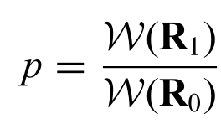
Metropolis Monte Carlo steps
We first randomly select a configuration R₀ inside the specified domain D.
Then W(R₀) is evaluated. A new configuration R₁ is tried (e.g., R₁=R₀+ΔR, where ΔR is between [−h, h]). The actual value of h is determined from the desired accepting rate.
In practice, h is commonly chosen so that the accepting rate of moves is around 50%.
We can evaluate the probability

Slide 65
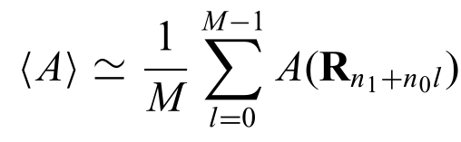
Comparing p with a uniform random number w_{i} in the region [0, 1]. If p ≥ w_{i} , the new configuration is accepted; otherwise, the old configuration is assumed to be the new configuration.
This procedure is repeated and the physical quantity A(R_{k} ) for k = n₁, n₁ + n₀, . . . , n₁ + (M -1)n₀ is evaluated. The numerical result of the integral is then given by

Slide 66
Note that the first n₁ steps are used to remove the influence of the initial selection. The data are taken n₀ steps apart to avoid high correlation between the data points.
In most cases, the distribution function W(R) varies by several orders of magnitude, whereas A(R) stays smooth or nearly constant.
This sampling by importance is much more efficient than the direct, random sampling presented in the preceding section.

Slide 67
Metropolis MC: Detailed Balance
Let T Take the Form:
= Probability to Choose a Particular Move
acc = Probability to Accept the Move
Metropolis Monte Carlo
Use:
N. Metropolis et al., J. Chem. Phys. 21, 1087 (1953)

Slide 69
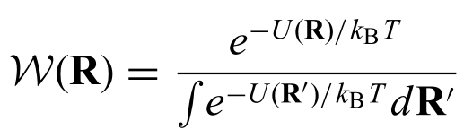
Applications in statistical physics
e.g., for canonical ensemble, the distribution function W(R) is given by
with U(R) being the potential energy of the system for a given configuration R. Here k_{B} is Boltzmann constant and T is temperature

Slide 70
Monte Carlo for continuous systems
Initialize the Positions
Calculate the Ensemble
Average
Select a Particle at Random,
Calculate the Energy
Yes
Finished
?
No
Give the Particle a Random
Displacement, Calculate the
New Energy
Accept the Move with

Slide 71
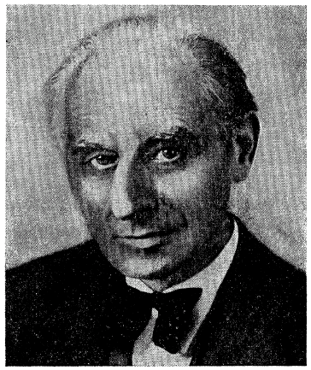
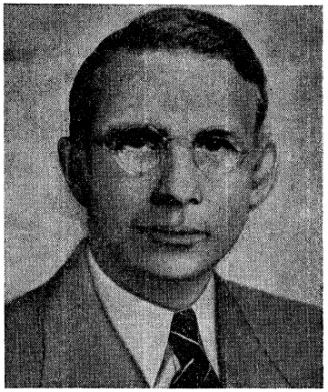
Discrete lattice system: Ising model
Wilhelm Lenz 1888-1957
Ernst Ising, 1900–1998
1920
1924

Slide 72
Ernst Ising was born in Cologne in 1900. After school, he studied physics and mathematics at the University of Göttingen and University of Hamburg. In 1922, he began researching ferromagnetism under the guidance of Wilhelm Lenz. He earned a Ph.D in physics from the University of Hamburg in 1924 when he published his doctoral thesis (an excerpt or a summary of his doctoral thesis was published as an article in a scientific journal in 1925 and this has led many to believe that he published his full thesis in 1925). His doctoral thesis studied a problem suggested by his teacher, Wilhelm Lenz. He investigated the special case of a linear chain of magnetic moments, which are only able to take two positions, "up" and "down," and which are coupled by interactions between nearest neighbors. Mainly through following studies by Rudolf Peierls, Hendrik Kramers, Gregory Wannier and Lars Onsager the model proved to be successful explaining phase transitions between ferromagnetic and paramagnetic states.

Slide 73
After earning his doctorate, Ernst Ising worked for a short time in business before becoming a teacher, in Salem, Strausberg and Crossen, among other places. In 1930, he married the economist Dr. Johanna Ehmer (February 2, 1902 - February 2, 2012). As a young German-Jewish scientist, Ising was barred from teaching and researching when Hitler came to power in 1933. In 1934, he found a position, first as a teacher and then as headmaster, at a Jewish school in Caputh near Potsdam for Jewish students who had been thrown out of public schools. Ernst and his wife Dr. Johanna Ising, lived in Caputh near the famous summer residence of the Einstein family. In 1938, the school in Caputh was destroyed by the Nazis, and in 1939 the Isings fled to Luxembourg, where Ising earned money as a shepherd and railroad worker. After the German Wehrmacht occupied Luxembourg, Ernst Ising was forced to work for the army. In 1947, the Ising family emigrated to the United States. Though he became Professor of Physics at Bradley University in Peoria, Illinois, he never published again. Ising died at his home in Peoria in 1998, just one day after his 98th birthday.

Slide 74
Spin: s_{i} = ±1
s = {s₁, s₂, …, s_{i}, … }
Ising model Hamiltonian
Total states: 2^{N}
Any physical observation
canonical ensemble
partition function

Slide 75
The Ising model was used historically to study magnetic phase transitions.
For the h = 0 case, there is a critical temperature T_{C} that separates different phases of the system. For example, the system is ferromagnetic if T < Tc, paramagnetic if T > Tc, and unstable if T = Tc. The complete plot of T , m, and h forms the so-called phase diagram.

Slide 76
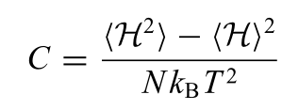
Another interesting application of the Ising model is that it is also a generic model for binary lattices: that is, two types of particles can occupy the lattice sites with two on-site energies which differ by 2h. So the results obtained from the study of the Ising model apply also to other systems in its class, such as binary lattices.
Other quantities of interest include, but are not limited to, the total energy E = <H> and the specific heat

Slide 77
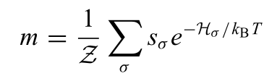
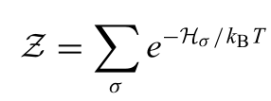
In order to simulate the Ising model, for example, in the calculation of m:
where s_{σ} = S_{σ} /N, with S_{σ} = Σs_{i} being the total spin of a specific configuration labeled by σ and H_{σ} being the corresponding Hamiltonian (energy).
The above summation is over all the possible configurations. Here Z is the partition function given by

Slide 78
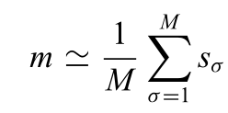
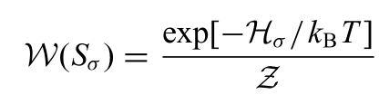
The average of a physical quantity, such as the magnetization, can be obtained from
with σ = 1, 2, . . . , M indicating the configurations sampled according to the distribution function

Slide 79
Outline of the steps
Start from a given spin configuration.
Choose a spin.
Change it.
Calculate the energy change ΔE=new-old. Compare the possibility p=exp[-ΔE/k_{B}T] with a PRN. If p<PRN, reject the change, else, accept the new configuration.
Repeat the above processes for many steps.
Perform measurements and calculate average.

Slide 80
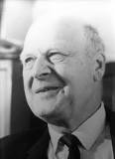
Lars Onsager (November 27, 1903 – October 5, 1976) was a Norwegian-born American physical chemist and theoretical physicist, winner of the 1968 Nobel Prize in Chemistry. He held the Gibbs Professorship of Theoretical Chemistry at Yale University.
During the 1940s, Onsager studied the statistical-mechanical theory of phase transitions in solids. He obtained the exact solution for the two dimensional Ising model in zero field in 1944.
for 1D chain: T_{C}=0 (Ising proved)
for 2D square lattice: K_{B}T_{C}/J=2/ln(1+sqrt(2))=2.26918531421 (Onsager proved)
for 3D lattice: ????

Slide 81
Code example
8.5.Ising.cpp
ising2d.f90

Slide 82
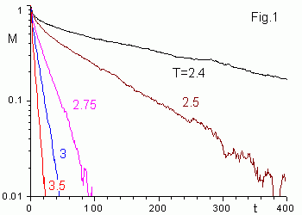
Critical slowing down
https://www.ibiblio.org/e-notes/Perc/ising1k.htm

Slide 83
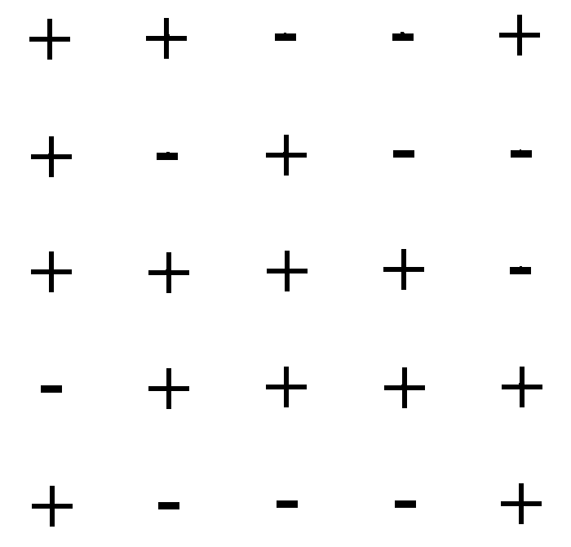
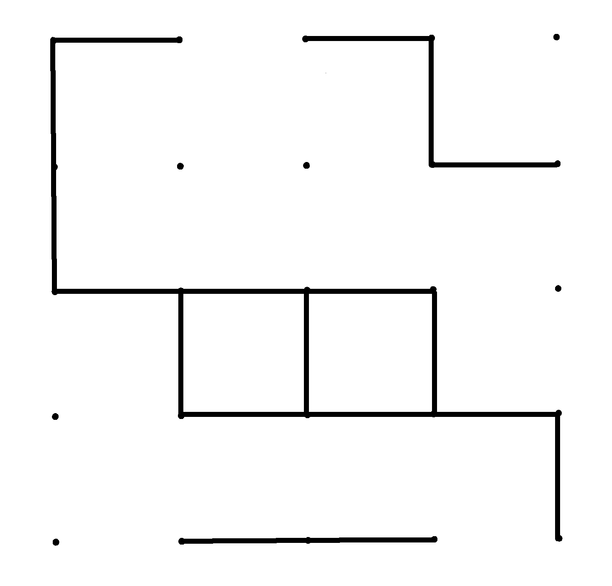
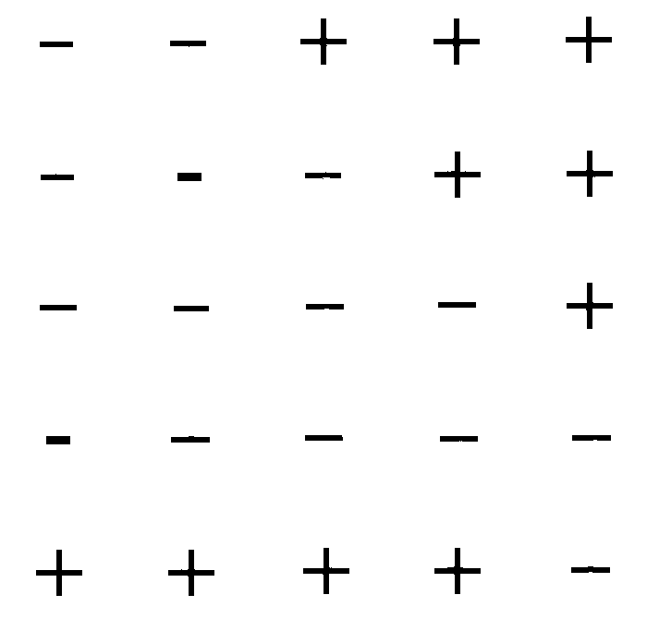
Cluster Flipping Methods
Swendsen-Wang method
Phys. Rev. Lett. 58, 86 (1987)
Choose an initial spin state.
Place bonds between each pair of spins with probability p.
Find all clusters i.e. connected networks of bonds.
Randomly assign a spin value to all sites in each cluster.
Erase bonds → new spin state.
original spins clusters formed “decorated” clusters

Slide 84
High T: clusters are small.
Low T: most nearest neighbors in the same state are in the same cluster ⇒ system oscillates between similar structures.
Near T_{c}: a rich array of clusters is produced and each configuration differs substantially from its predecessor
⇒ critical slowing down is reduced!

Slide 85
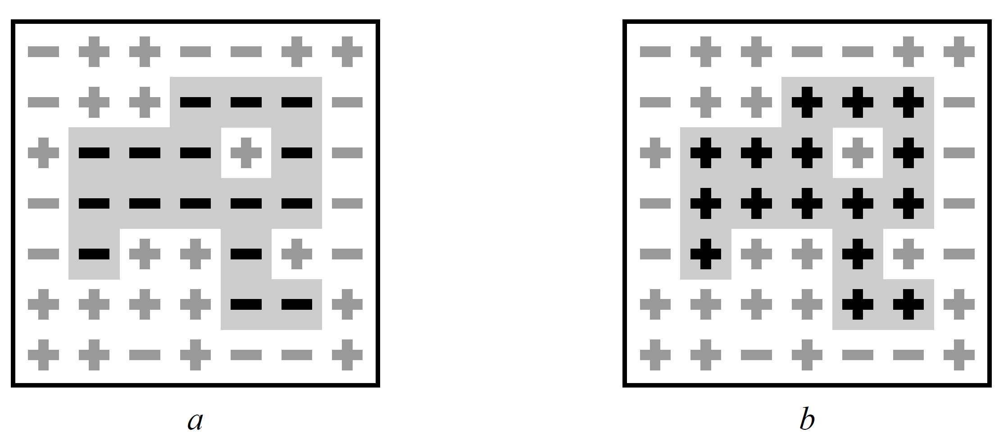
Wolff method
Phys. Rev. Lett. 62, 361 (1989)
Grow single clusters and flip them sequentially:
Randomly choose a site.
Draw bonds to all nearest neighbors that are in the same
state with probability p = 1 – e^{-K}. Repeat, iteratively,
to form a cluster of connected sites.
Flip the entire cluster of connected sites.
Choose another initial site and repeat the process.
Wolff kinetics has a smaller prefactor and smaller dynamic
exponent than does the Swendsen-Wang method.

Slide 86
Quantum Monte Carlo Simulations
Many Body Schrodinger Equation
Variational Monte Carlo

Slide 87

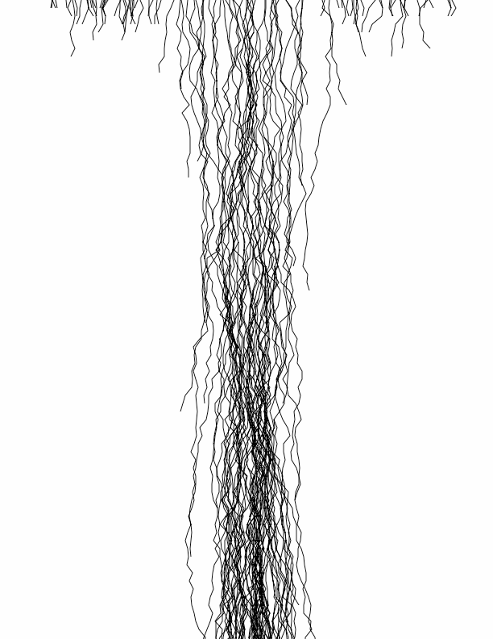

Diffusion Monte Carlo Simulations
Initial
Let τ = it,
As τ -> ∞, only the ground state survive.
walkers
τ
Schrödinger equation
→diffusion equation
Diffusion
Birth/death
Generate walkers with a guess distribution
Each time step: Take a random step (diffuse); A walker can either die, give birth, or just keep going
Final
Warning: Fermion Sign Problem!

Slide 88
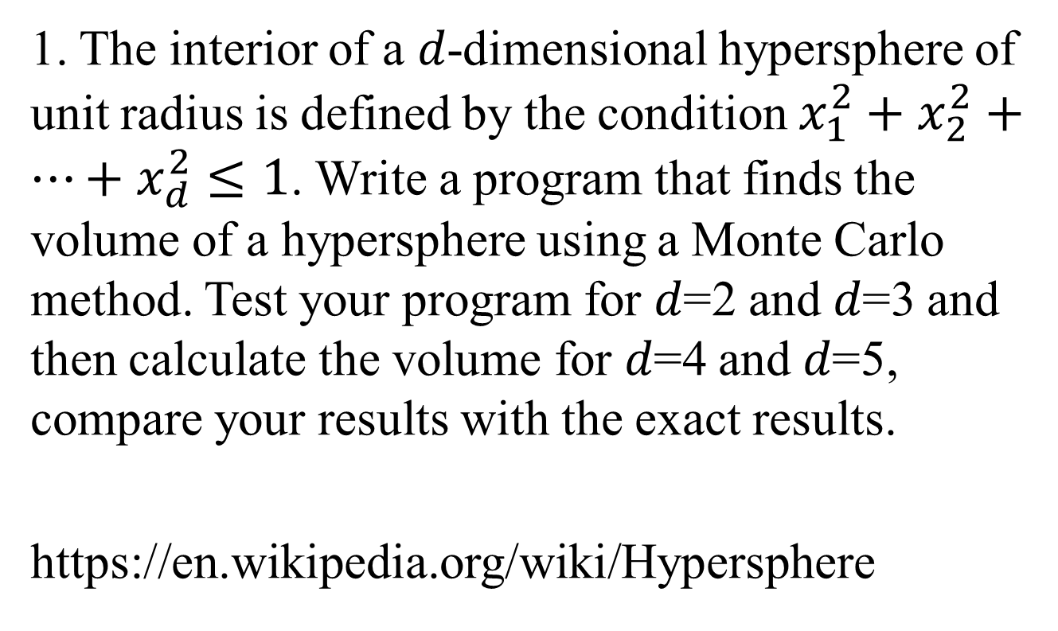
Homework
1. The interior of a 𝑑-dimensional hypersphere of unit radius is defined by the condition $x_{1}^{2}+x_{2}^{2}+⋯+x_{d}^{2}≤1$. Write a program that finds the volume of a hypersphere using a Monte Carlo method. Test your program for 𝑑=2 and 𝑑=3 and then calculate the volume for 𝑑=4 and 𝑑=5, compare your results with the exact results.
https://en.wikipedia.org/wiki/Hypersphere

Slide 89
2. Write a MC code for a 3D Face-Centered Cubic lattice using the Heisenberg spin model (adopt periodic boundary condition). Estimate the ferromagnetic Curie temperature.
https://www.physics-in-a-nutshell.com/article/11/close-packed-structures-fcc-and-hcp
To generate a randomly orientated 3D vector, you can refer to http://www.sklogwiki.org/SklogWiki/index.php/Random_vector_on_a_sphere
Or
http://corysimon.github.io/articles/uniformdistn-on-sphere/

